Slide 1
EDUC2323 Computer Programming as a Tool for Learning

Slide 2
Plan
Advanced Scratch concepts: broadcasting and simple animation
Activities:
  Analysing broadcasting demo project

Slide 3

What is Broadcasting?
Broadcasts are ‘messages sent throughout the whole Scratch environment
Messages activate receiving scripts, but only if they are set up to ‘receive’ a specific message.
What can these be used for?
  ‘On hit detection’ – do some action after hit detected or something specific happens
  On Mouse click – do some action after mouse down detected
  To divide up and control a project – e.g. to do some action when your program goes from one state to another or transfer control from one script/sprite to another
Notes:
First see if anyone has played around with broadcasting and knows what it can do, what it’s used for.
I’d like to think about broadcasting like a radio tower, when a radio tower sends out a signal it’s broadcasting something and all the people it’s broadcasting out to are expecting to receive something.

Slide 4


Broadcasting Related Blocks
Broadcast ()
  Makes the specified broadcast and has no further effect
Broadcast () and Wait
  Makes the specified broadcast and freezes its script until all of the receiving scripts have finished
When I Receive ()
  Stays inactive until it receives the specified broadcast. Once it has been received, the script goes into action and ends once it has finished but can be triggered more than once, i.e. if that broadcast is received again.
Notes:
So what kind of blocks would you expect to see relating to broadcasting:
Some sort of broadcast message
Some sort of waiting to receive message
Example of why you need the Broadcast and wait: if you’re programing an ATM, then once someone sends out a withdraw or deposit money broadcast, you want to make sure the receiving scripts run first before you proceed.
Demo how to use the blocks

Slide 5
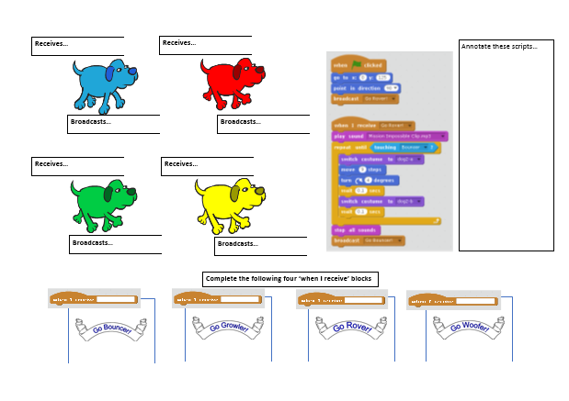
Activity: Analysing the provided broadcast example
Have a look at the third demo project in detail:
https://scratch.mit.edu/projects/138840667/
Check you can follow how each dog triggers the next dog to start running using broadcast messages.
Check you can follow how broadcast messages are also used to change the backdrop images
Explore how the dogs’ movement is animated using costume change and wait messages

Slide 6
Practical activities
Analyse the ‘Broadcasting – full example’ project
  Complete the A3 worksheet
Working on own project

